Slide 1

GAINING THE COMPETITIVE EDGE
Analyzing Candidate-Party Congruence and Issue Salience of Campaign
Winners in the 2021 German Federal Elections
Philipp Kläger
SNR: 2062105

Slide 2
I. Introduction
Figure 1. Poll history for the 2021 German Federal Elections (own rep.; based on Forsa 2022)
Motivation
Tight electoral campaigning for 2021 German Federal Elections (fig. 1)
Using text analytics methods to analyze political marketing strategies
Provide novel research results for the application of the wordscore procedure on tweets
Goal
Identify differences in the political marketing strategies between campaign winners and losers with text analytics methods

Slide 3
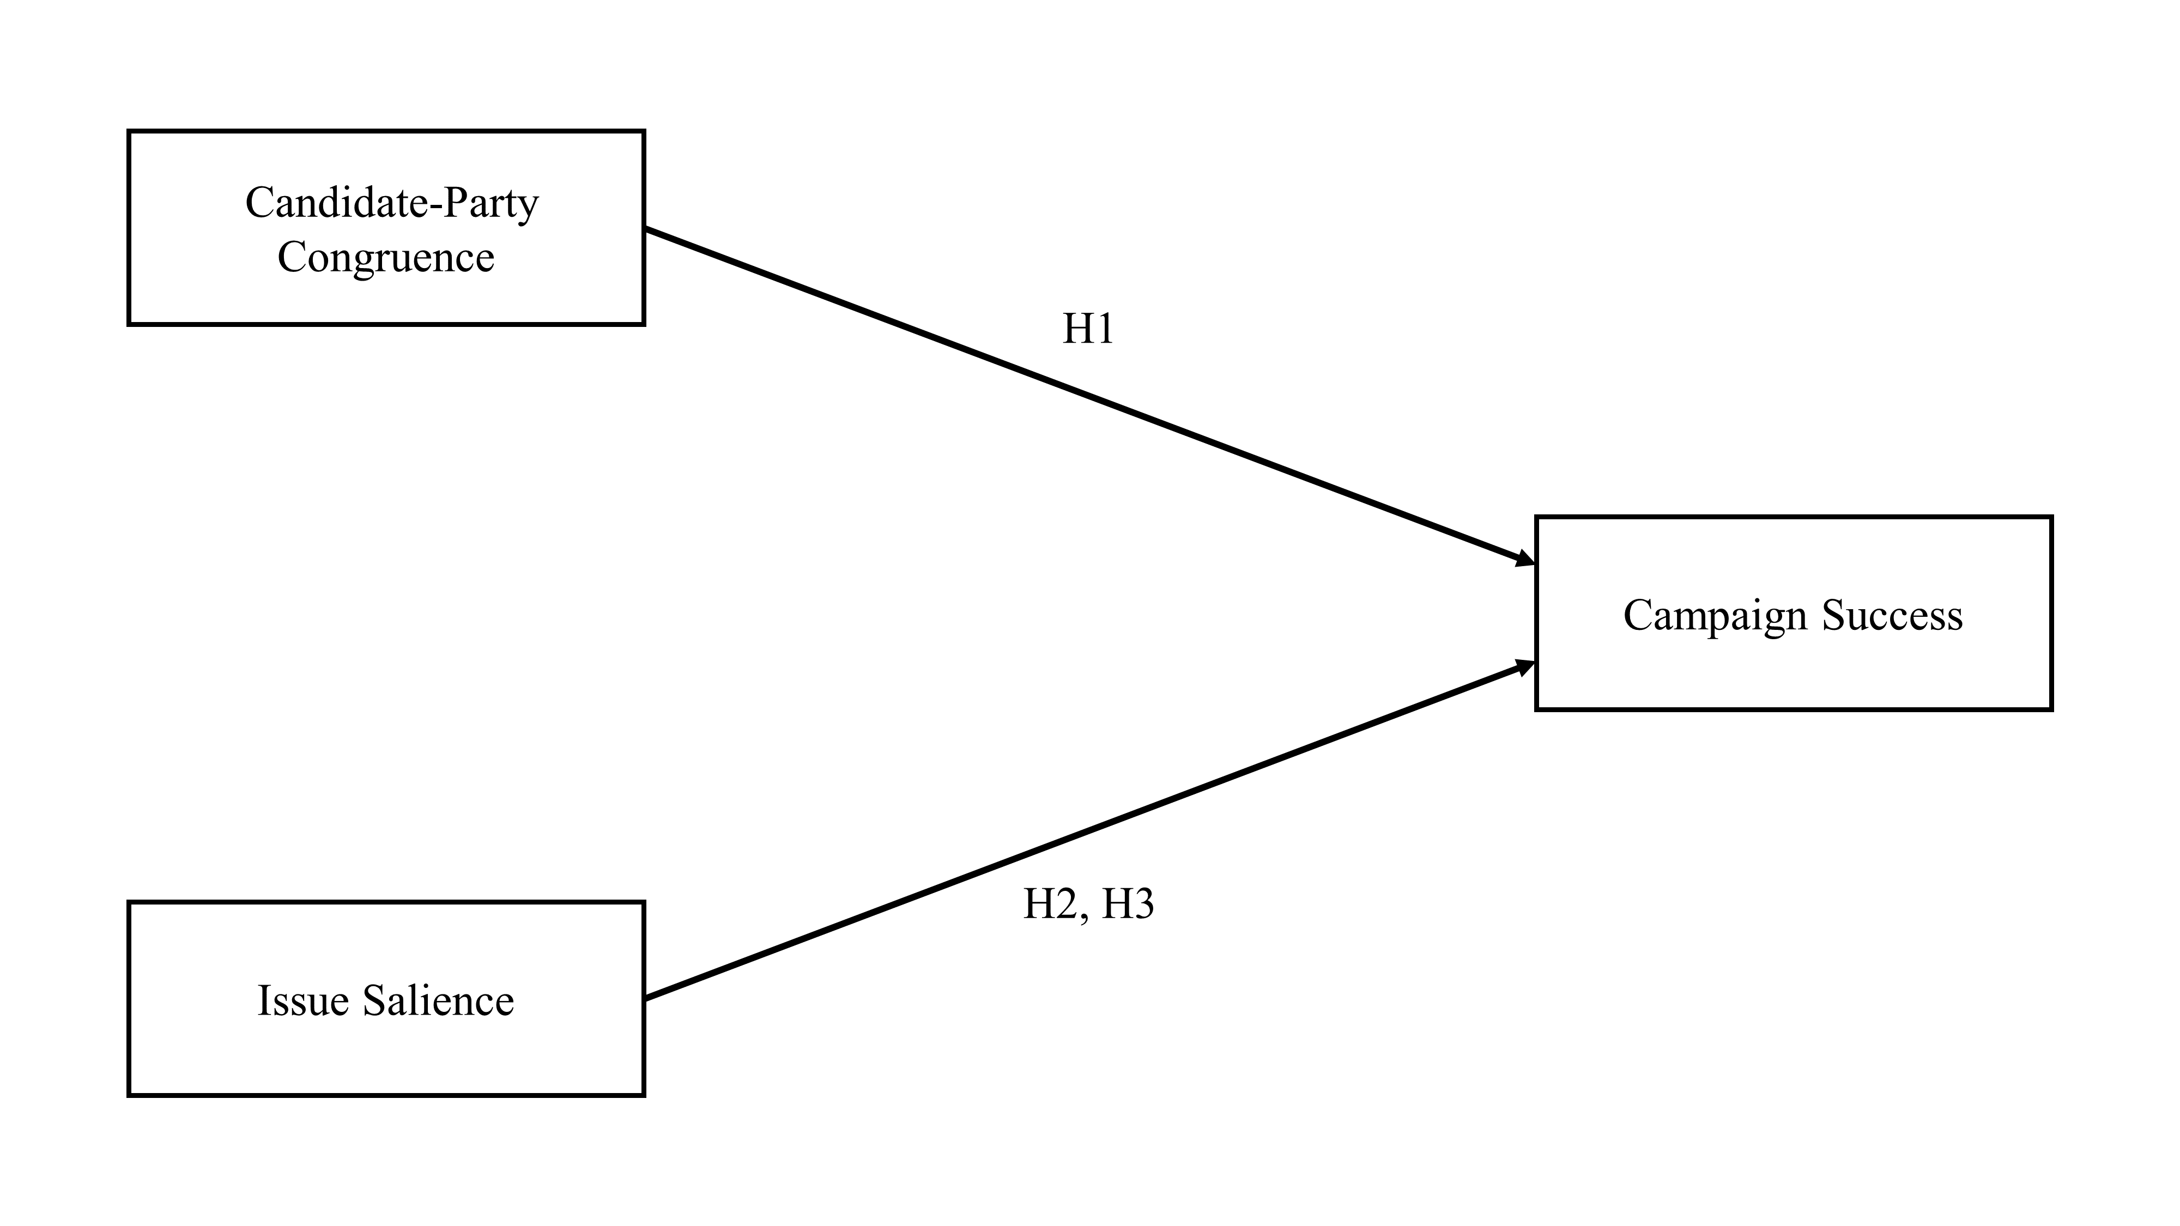
II. Model
Correlational Research Design (ANOVA tests + Tukey Post-hoc tests)
Six Parties: AfD, CDU/CSU, FDP, Greens, The Left & SPD
Campaign Groups: campaign winners vs. campaign losers
Expectations: higher level of candidate-party congruence (H1) and issue salience (H2 + H3)
Figure 2. Conceptual Model (own rep.)

Slide 4
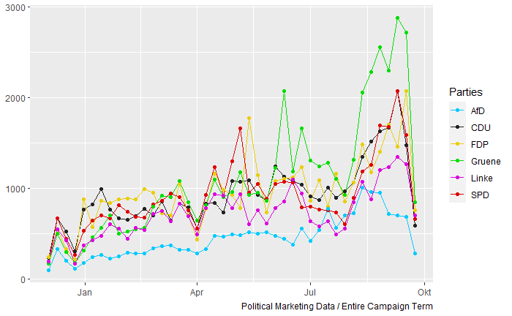
III. Data
Campaign period: Dec. 8, 2020 – Sep. 26, 2022
Two data sets collected:
Data 1. Candidate Tweets (218,256 observations)
Data 2. Party Manifestos (2017 & 2021 German Federal Elections)
Figure 3. Total volume of candidate tweets (own rep.).

Slide 5
IV. Methodology
Table 1. Wordscore Procedure (own rep.)
 | Methodological Procedure (Laver et al., 2003; Martin & Vanberg, 2007) | Application of this Research
Step 1. | A Priori Model Calibration collecting reference texts assigning reference scores to reference texts collecting virgin texts | 2017 party manifestos 2019 Chapel Hill Expert Survey 2021 party manifestos and 2021 campaign period tweets
Step 2. | Computing Wordscores & Reference Textscores
Step 3. | Computing Virgin Textscores
Step 4. | Robust Transformation of Scores
Step 5. Difference Testing
ANOVA Tests + Tukey Post-Hoc Tests

Slide 6
V. Results
Significant correlation between a higher level of candidate-party congruence for the campaign winners compared to the campaign losers
Issue Salience
topic Corona is discussed with very similar word usage
topic Environment is discussed with coherently more left-wing oriented word usages by all parties
no significant difference between campaign winners and losers

Slide 7
VI. Conclusions
Results emphasize the need to further study and build robust measures of candidate-party congruence
Parties and candidates should closely work together to ensure a congruent messaging on social media
In line with current research: consistent advertising messages are correlated with increases in online WOM and voter preference (Fossen et al., 2022)

Slide 8
THANK YOU FOR YOUR ATTENTION!
Philipp Kläger
SNR: 2062105

Slide 9
Sources
Forsa. (2022). Sonntagsfrage – Forsa (Wahlumfragen zur Bundestagswahl) [Sunday Surveys - Forsa (electoral surveys regarding the German Federal Elections)]. Wahlrecht.de / Forsa Institute. Retrieved March 3, 2022, from https://www.wahlrecht.de/umfragen/forsa.htm
Fossen, B. L., Kim, D., Schweidel, D. A., & Thomadsen, R. (2022). The role of slant and message consistency in political advertising effectiveness: evidence from the 2016 presidential election. Quantitative Marketing and Economics. https://doi.org/10.1007/s11129-021-09246-x
Laver, M., Benoit, K., & Garry, J. (2003). Extracting Policy Positions from Political Texts Using Words as Data. American Political Science Review, 97(02). https://doi.org/10.1017/s0003055403000698
Martin, L. W., & Vanberg, G. (2007). A Robust Transformation Procedure for Interpreting Political Text. Political Analysis, 16(1), 93–100. https://doi.org/10.1093/pan/mpm010

